Slide 1
COVID-19 Statistics
13-07-2020

Slide 2
Latest Statistics
(updated 13-07-2020)
Total confirmed cases worldwide: 13,102,569
192,933 new cases (1% increase)
Total fatal cases worldwide: 573,027
3,914 new fatalities (0% increase)
Israel recorded 40,632 cases in total
increased by 1,962 cases (5% increase)
43.0# in confirmed cases, 58.0# in mortality
29.0# in cases per capita, 58.0# in mortality rate

Slide 3
Latest Statistics
(updated 13-07-2020)
Worldwide mortality rate: 4.4% (-0.0%)
Israel mortality rate: 0.9% (-0.0%)
US has most cases in total (3,363,056)
US has most fatal cases in total (US)
US recorded the most new cases (58,114)
Brazil recorded the most new fatal cases (733)

Slide 4
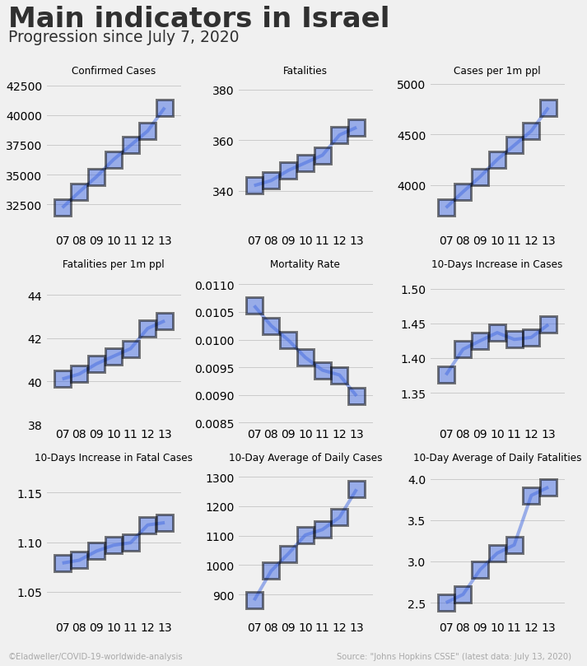

Slide 5
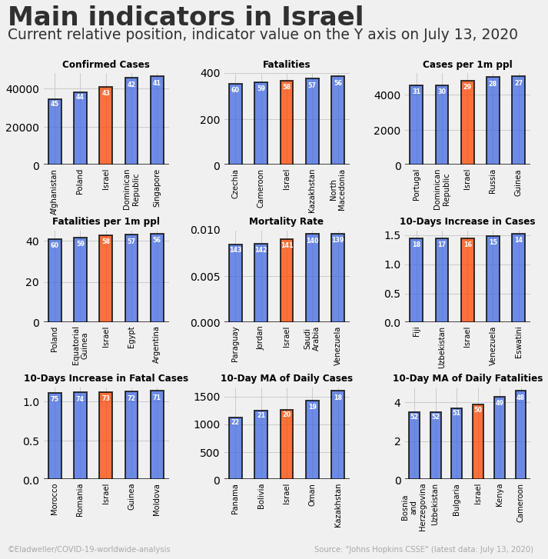

Slide 6
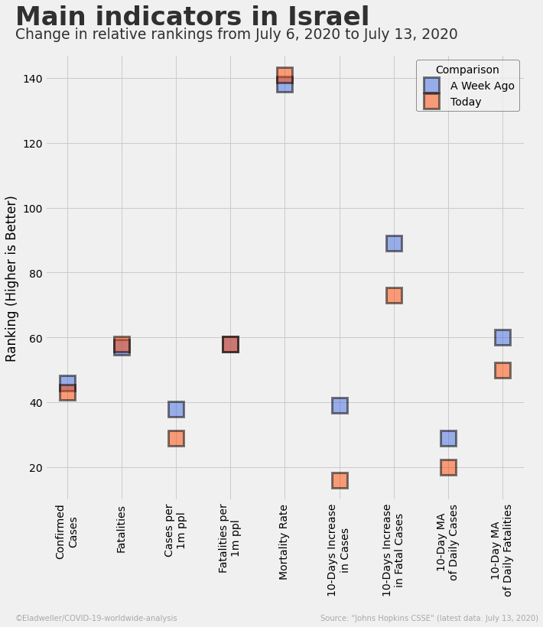

Slide 7
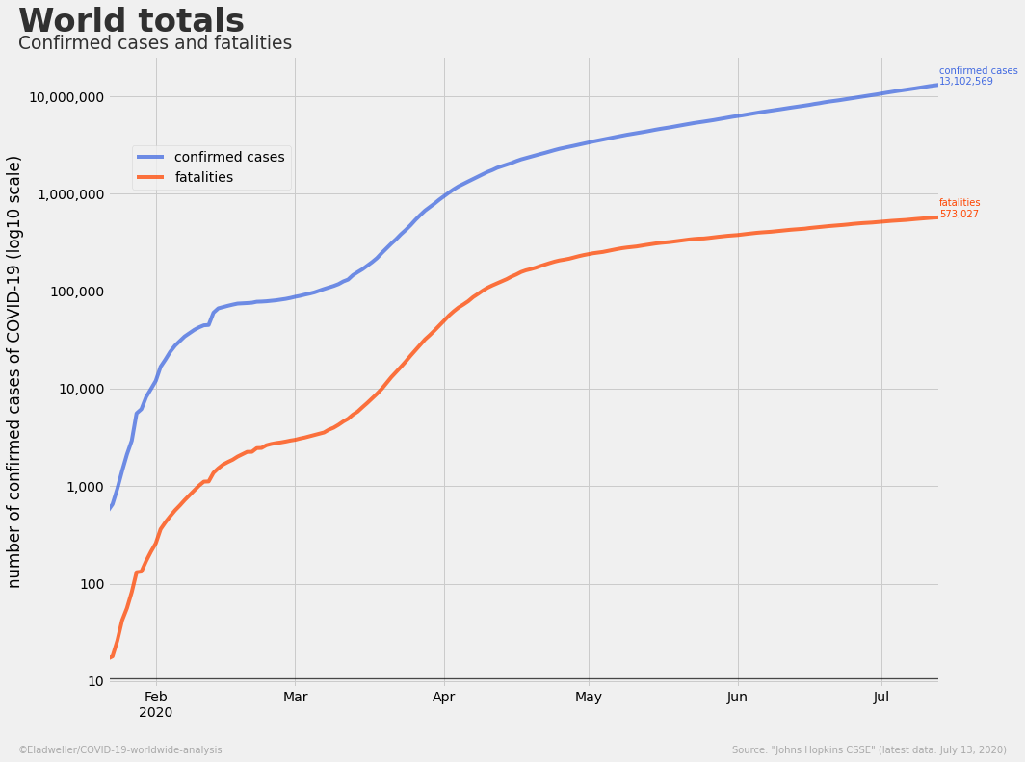

Slide 8
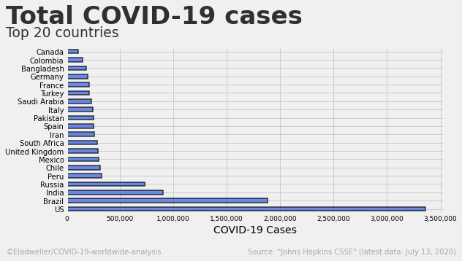

Slide 9
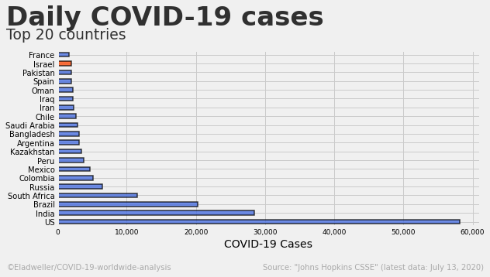

Slide 10
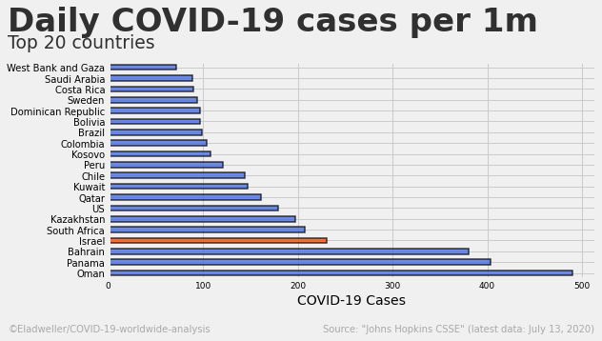

Slide 11
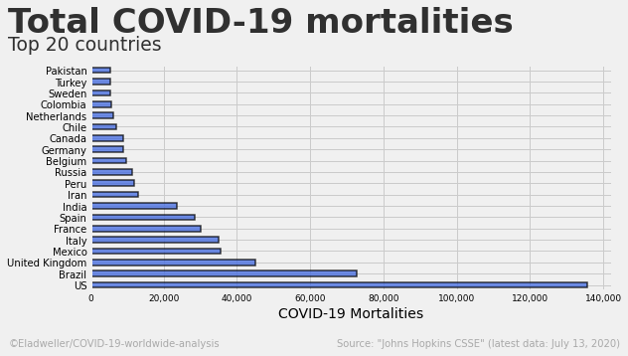

Slide 12
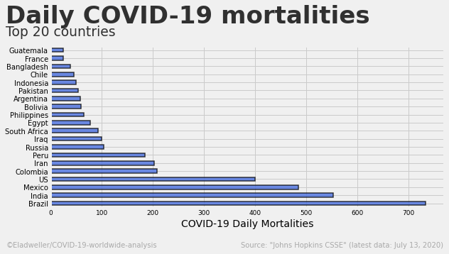

Slide 13
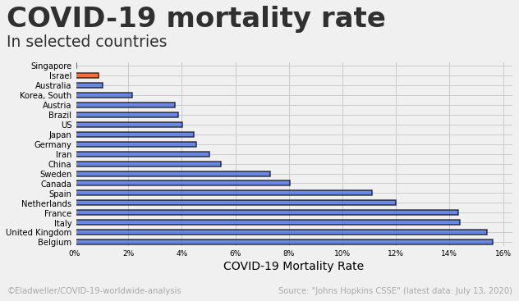

Slide 14
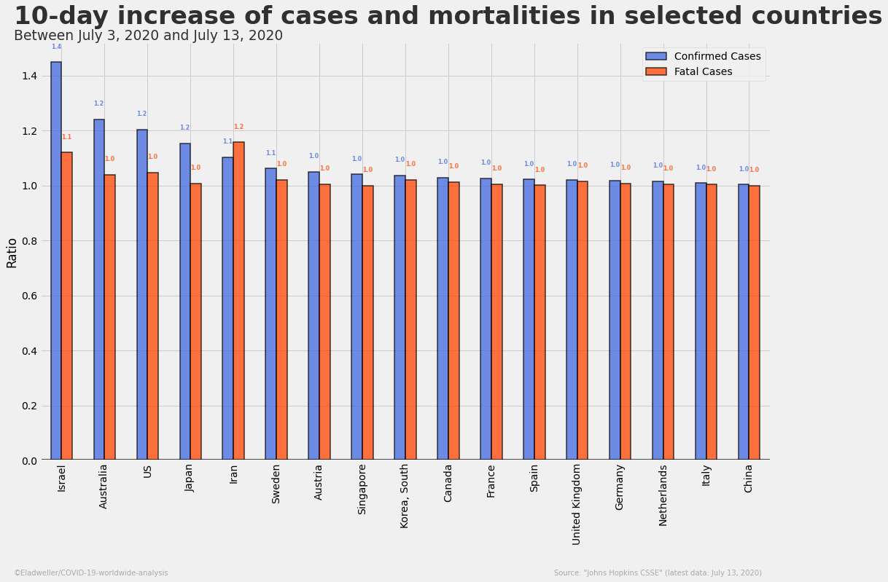

Slide 15
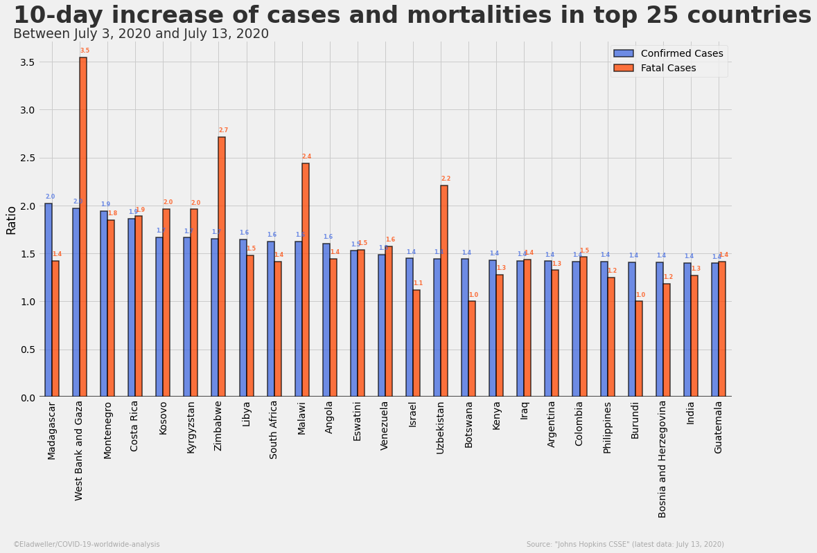

Slide 16
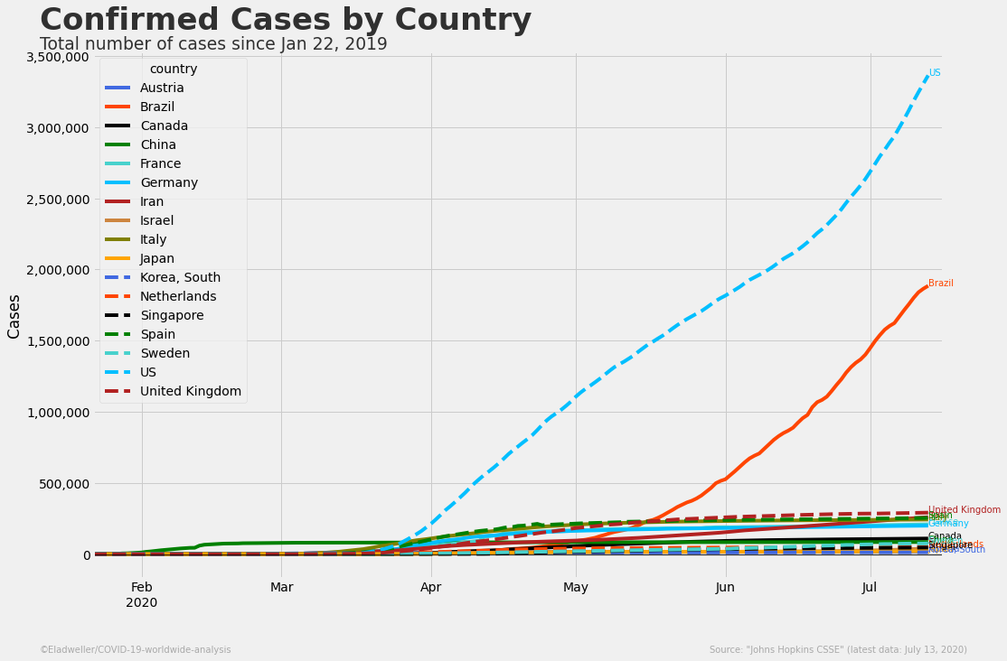

Slide 17
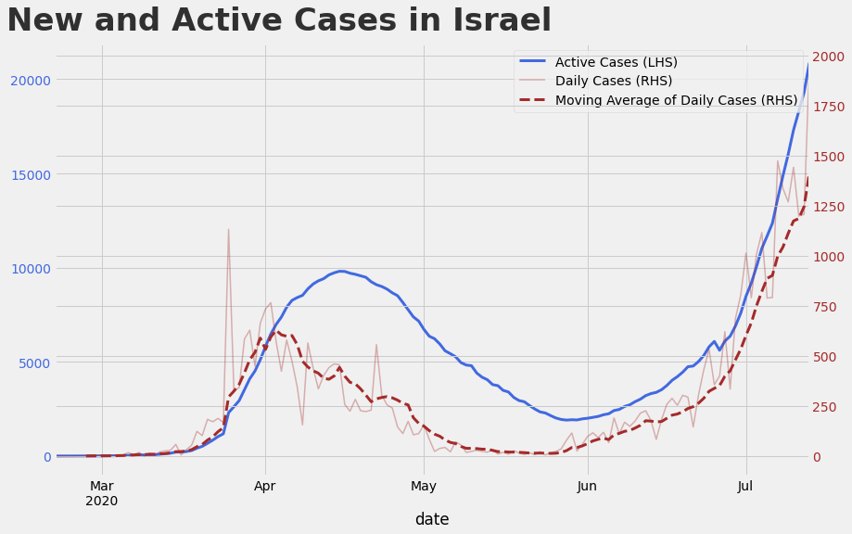

Slide 18
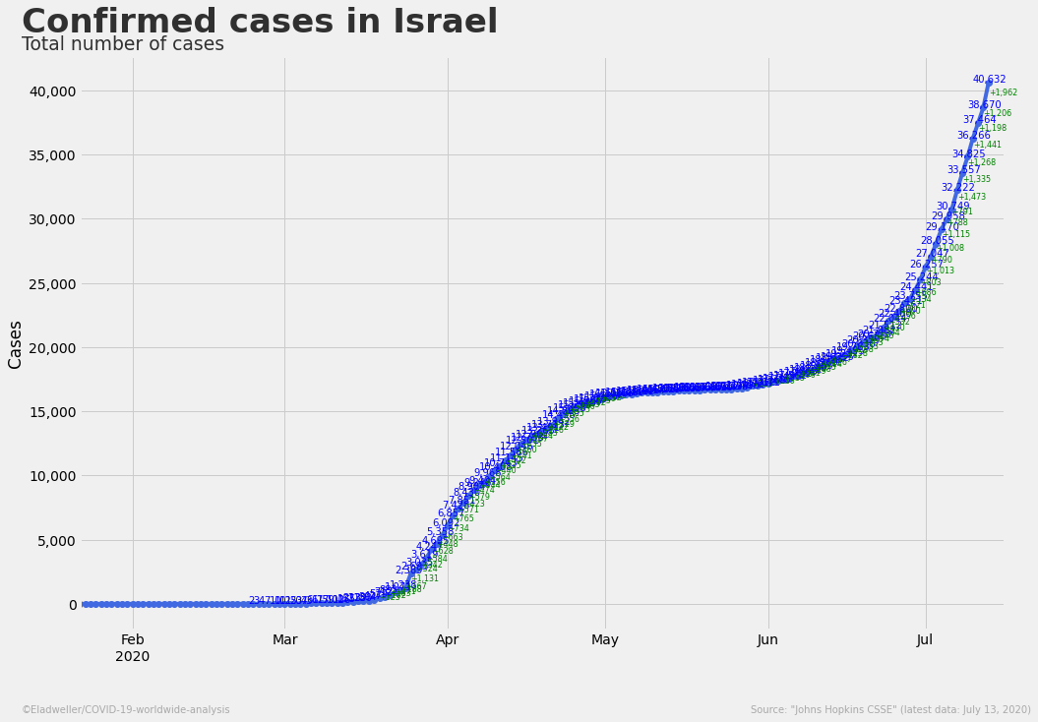

Slide 19
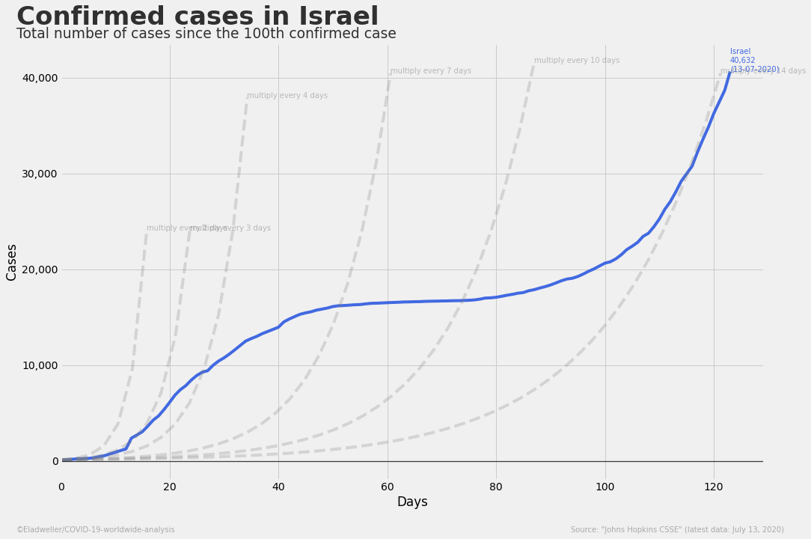

Slide 20
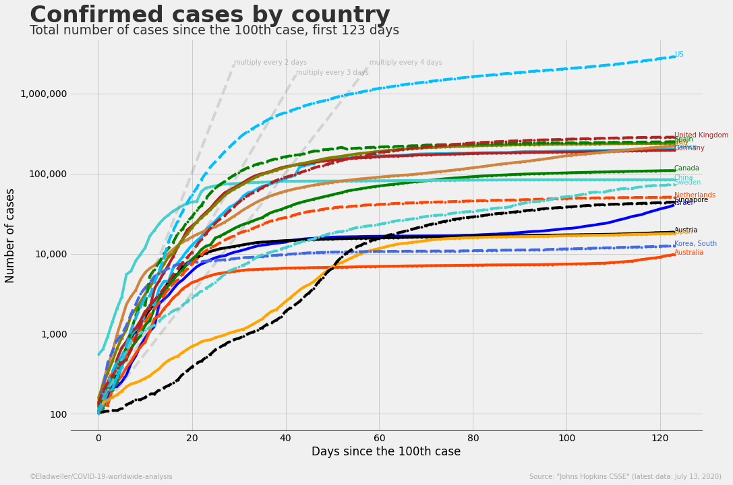

Slide 21
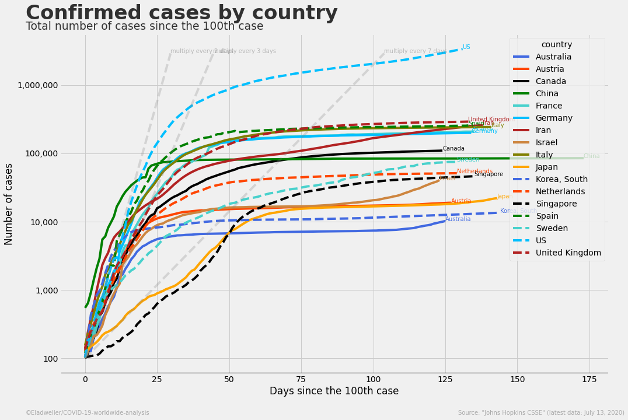

Slide 22
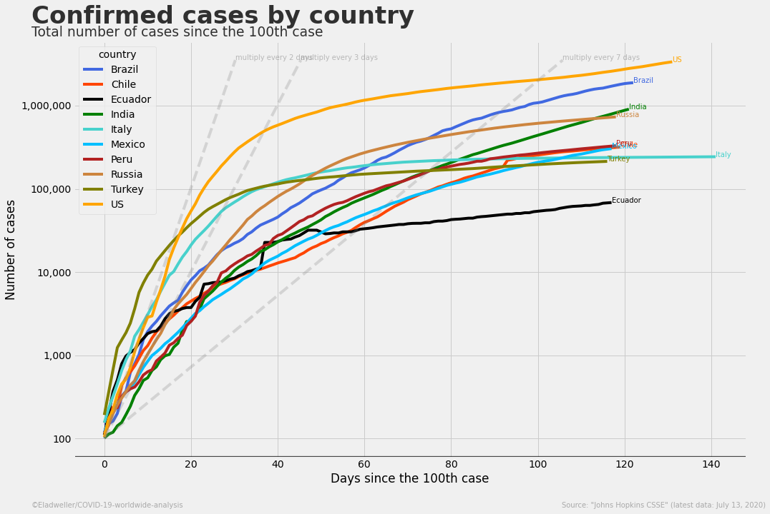

Slide 23
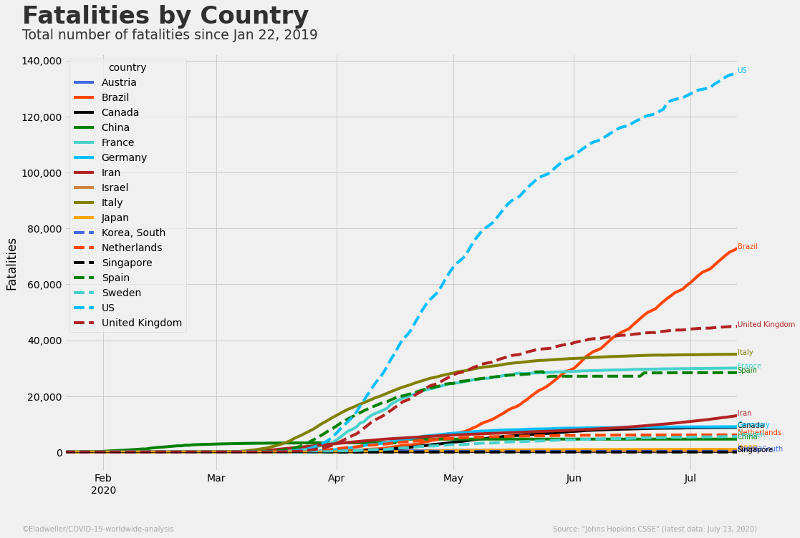

Slide 24
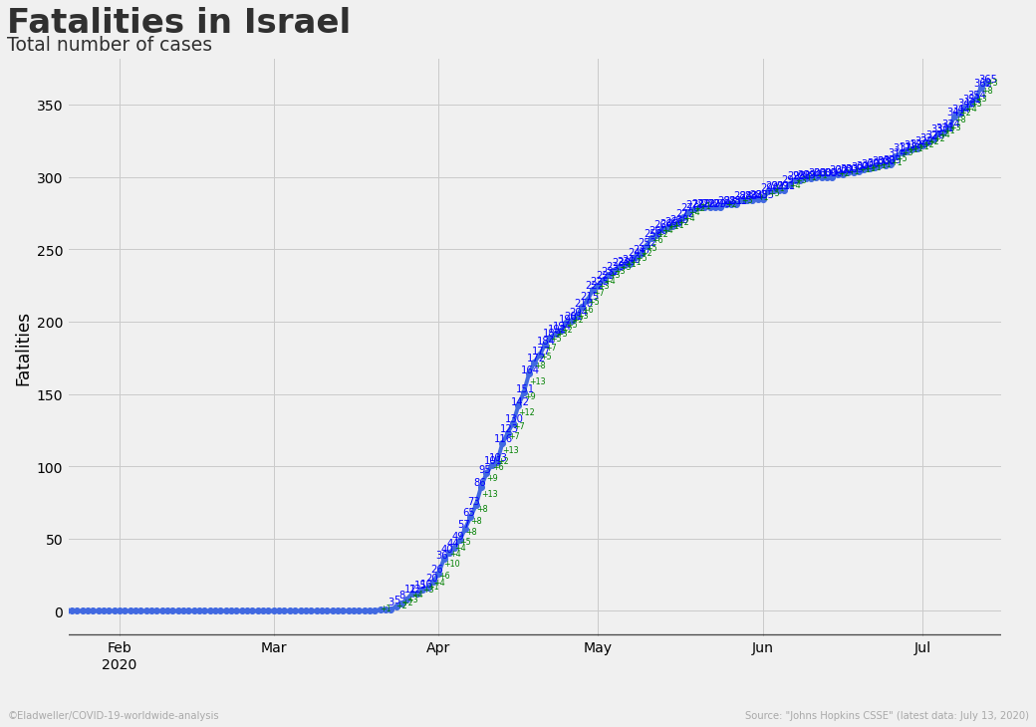

Slide 25
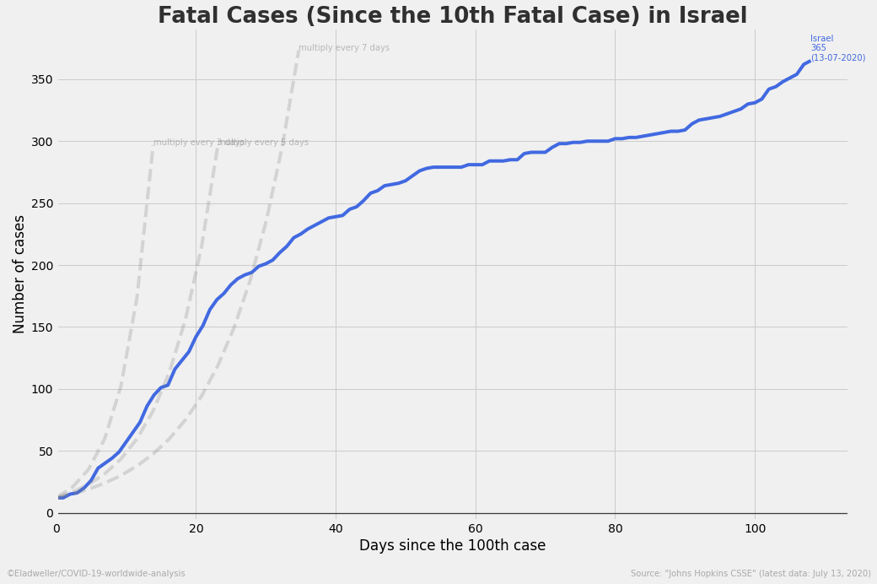

Slide 26
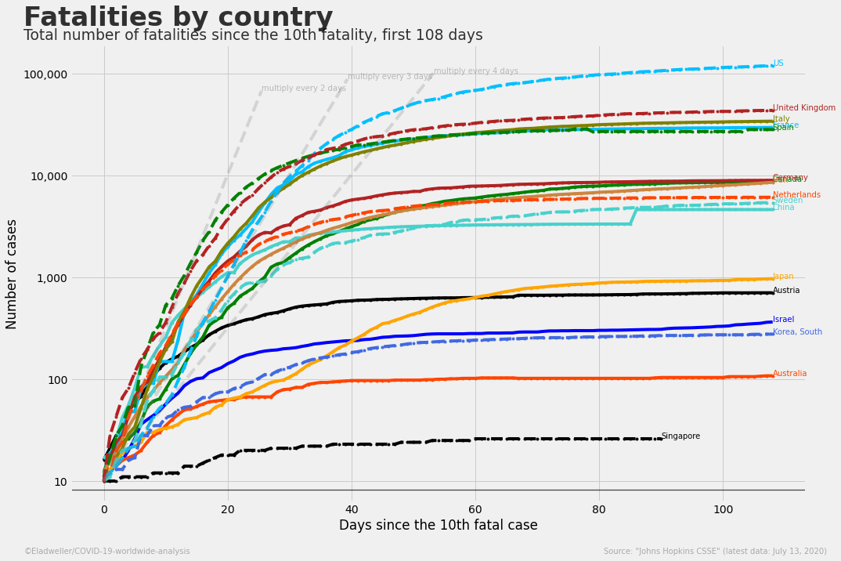

Slide 27
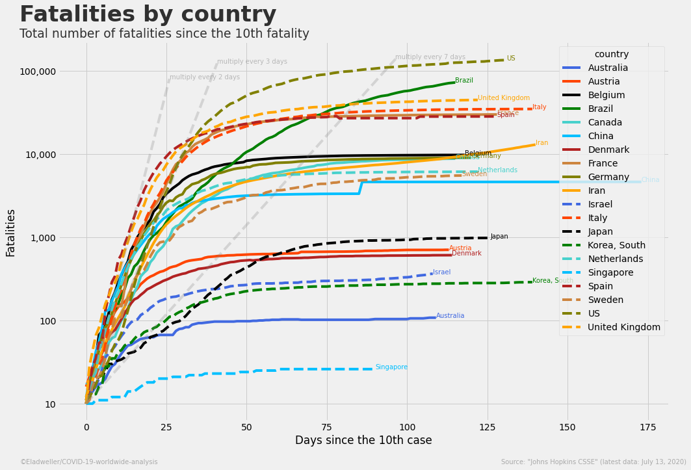

Slide 28
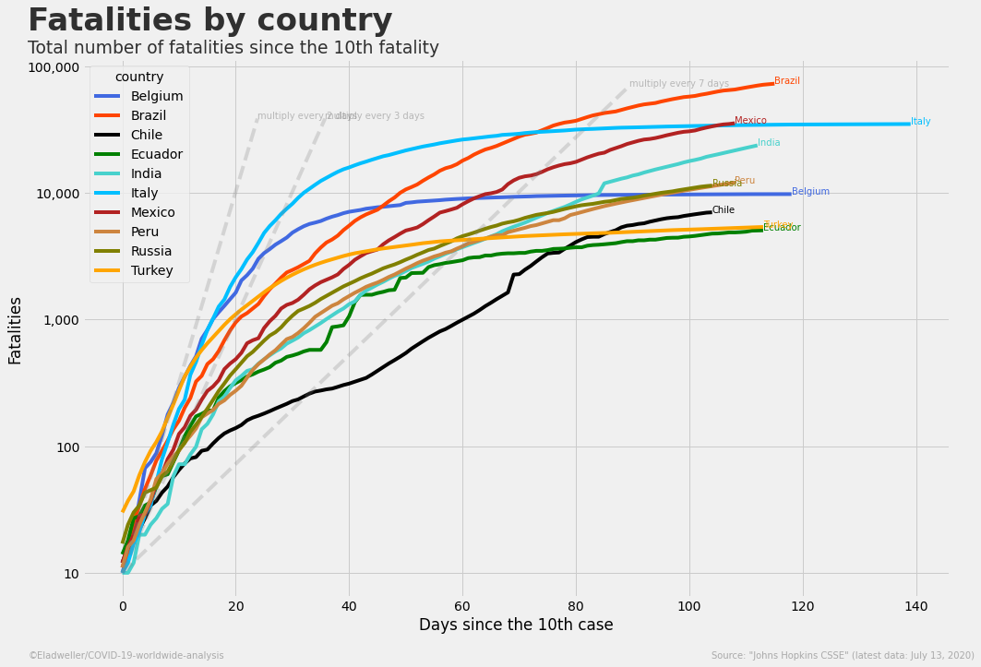

Slide 29
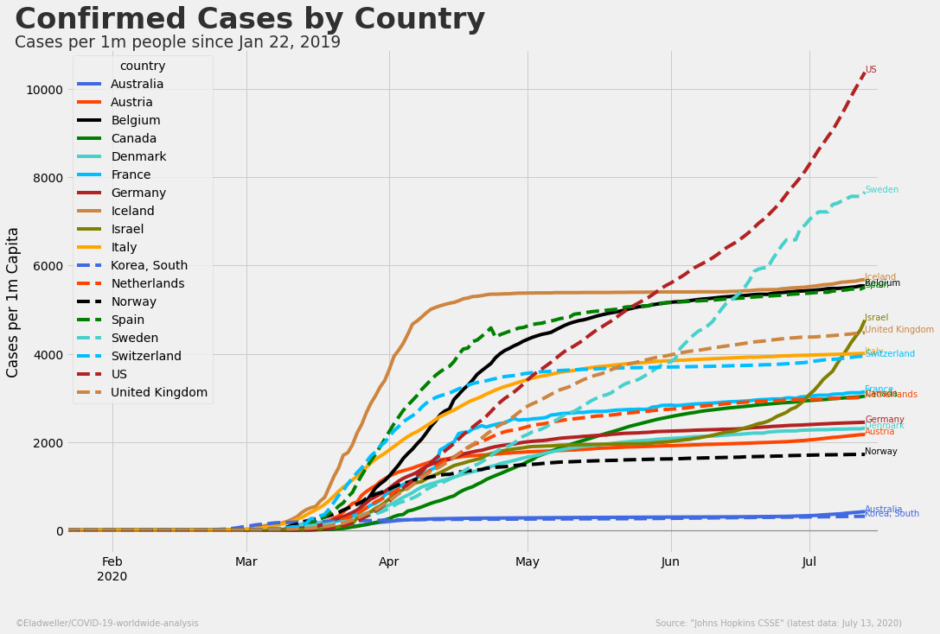

Slide 30
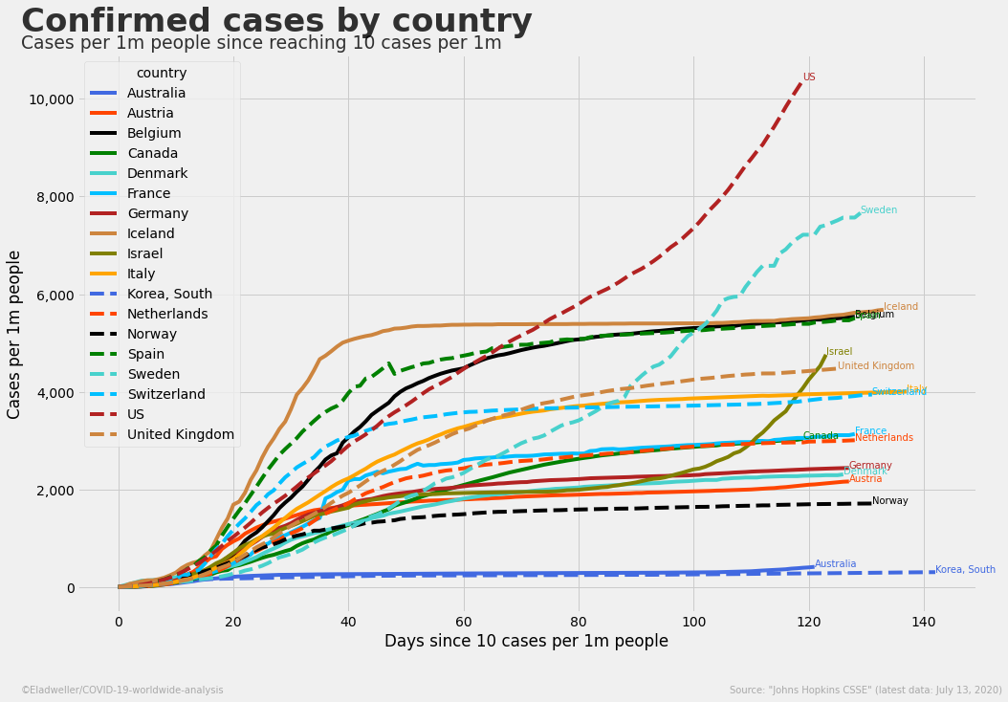

Slide 31
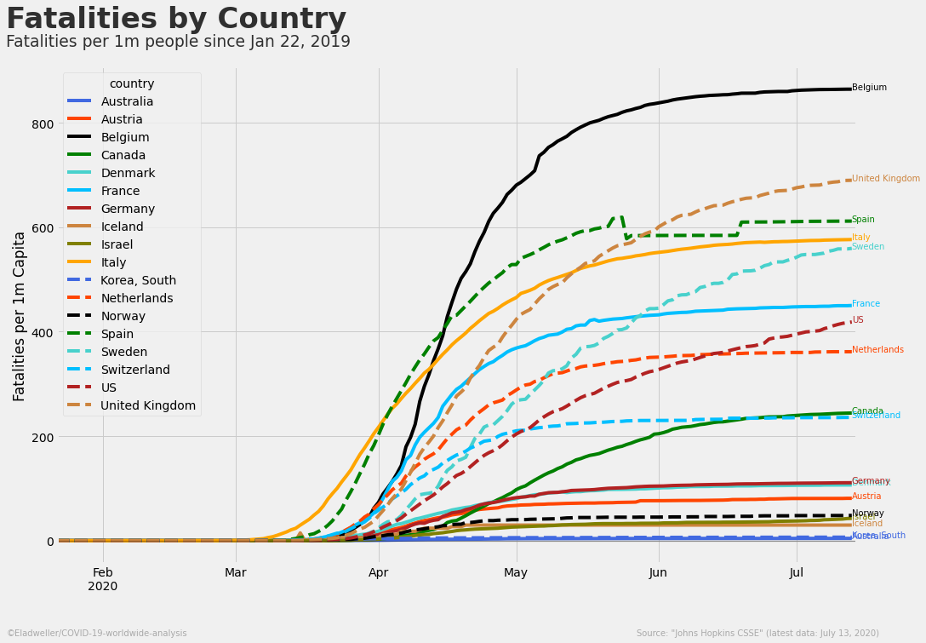

Slide 32
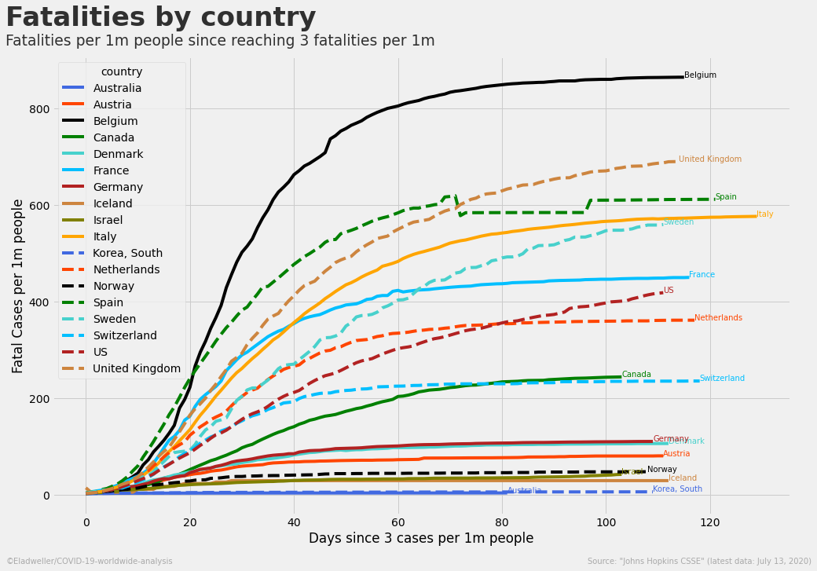

Slide 33
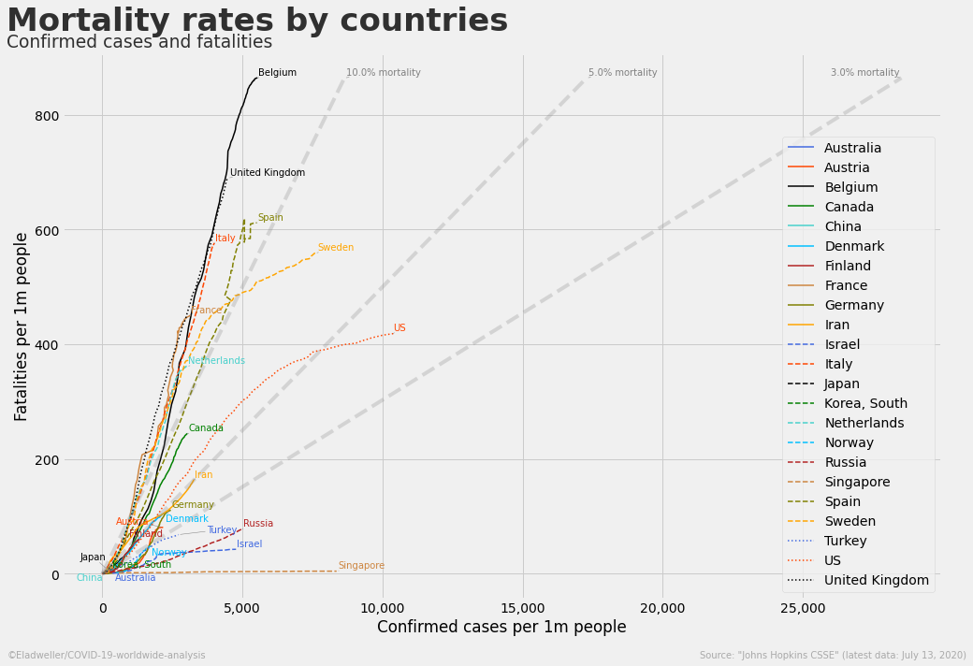

Slide 34
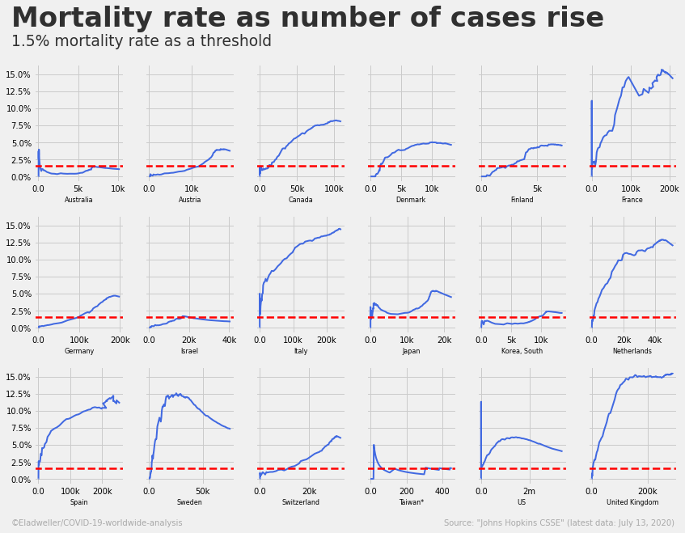

Slide 35
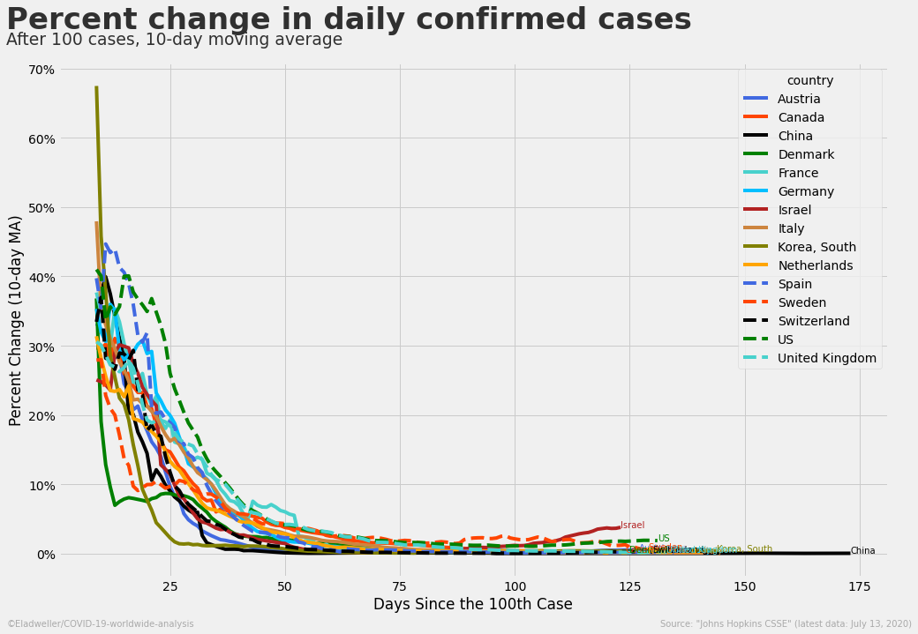

Slide 36
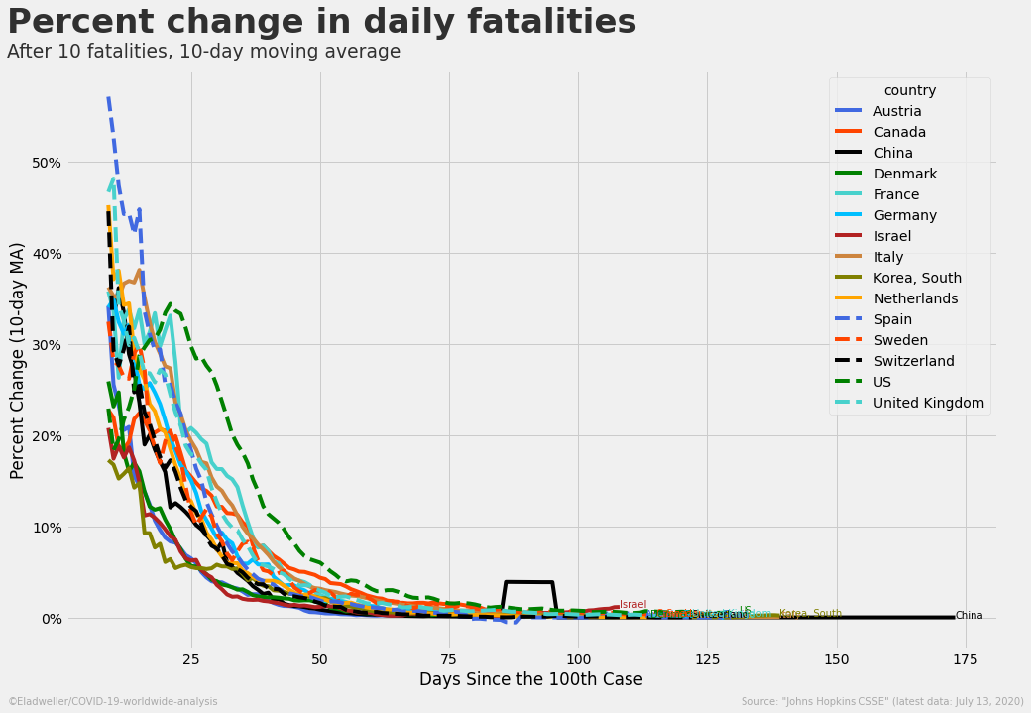

Slide 37
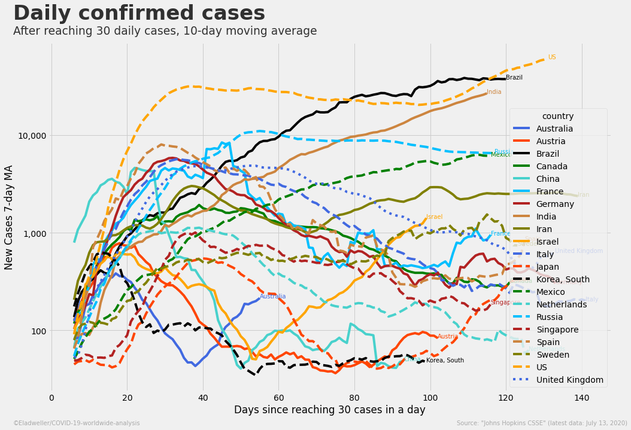

Slide 38
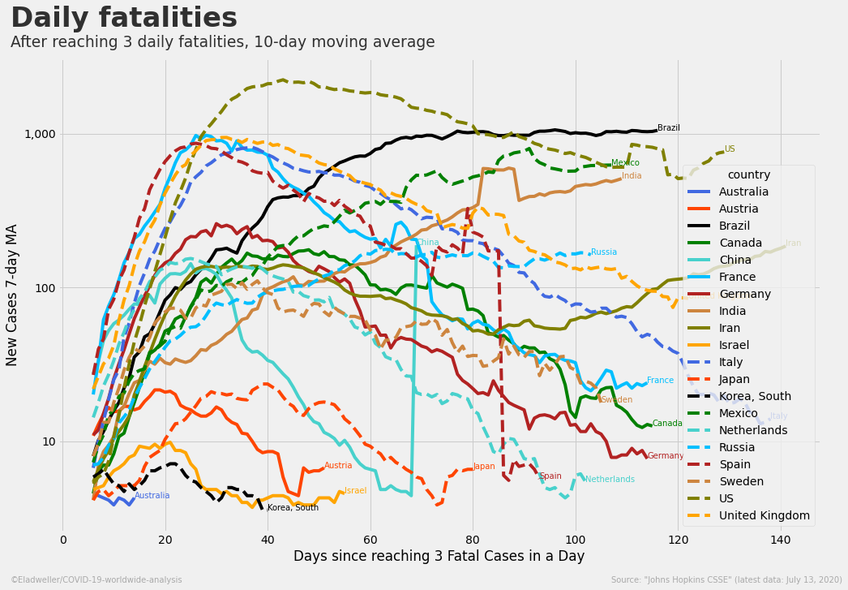

Slide 39
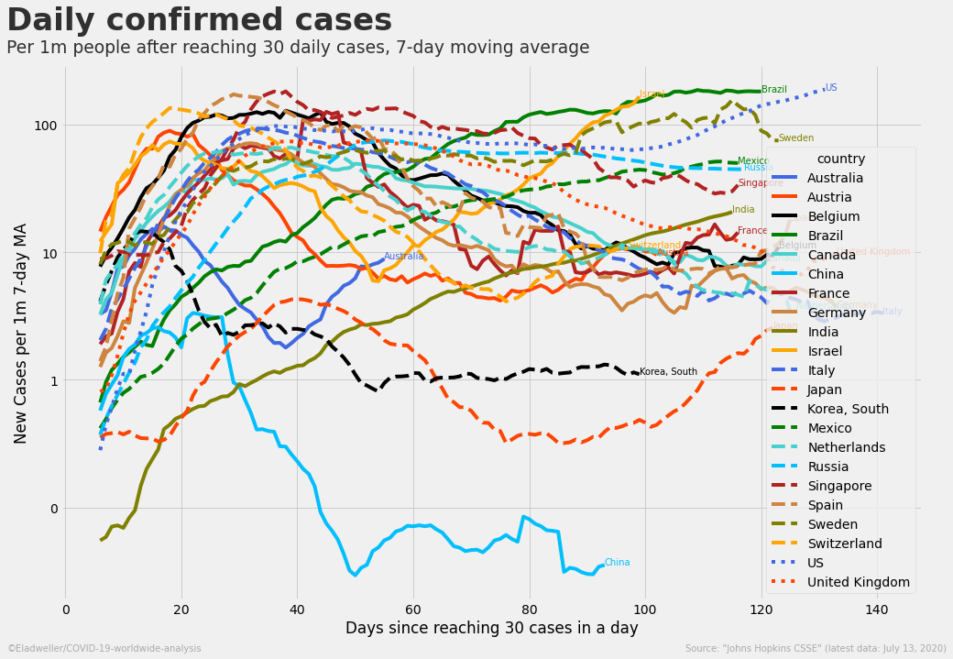

Slide 40
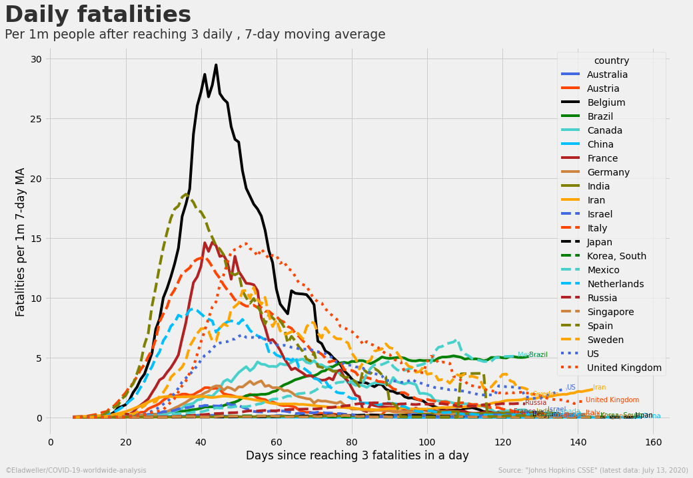

Slide 41
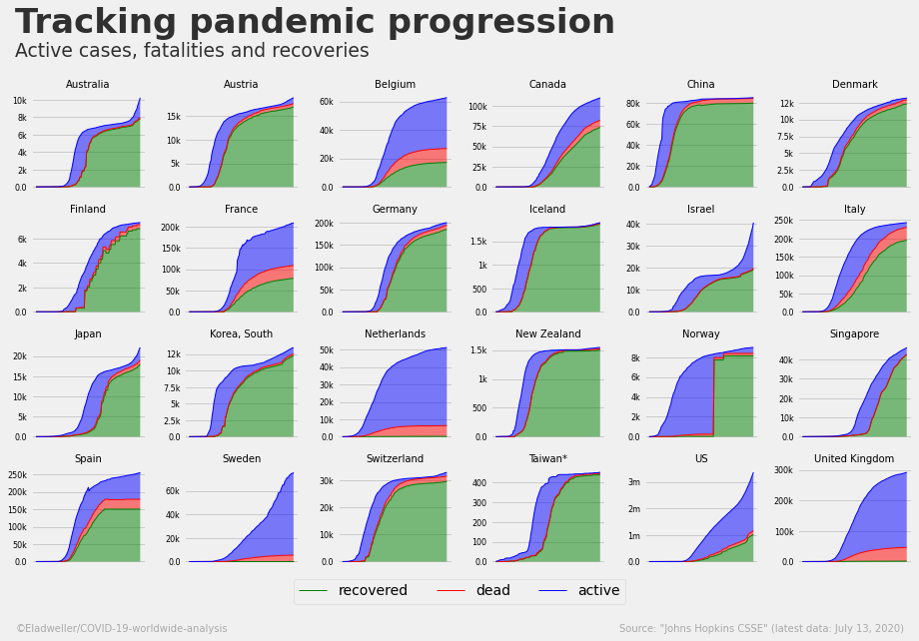

Slide 42
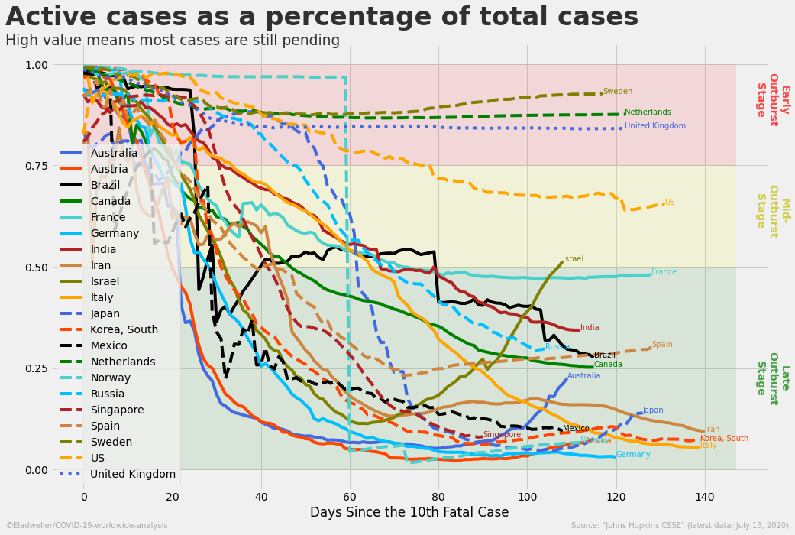

Slide 43
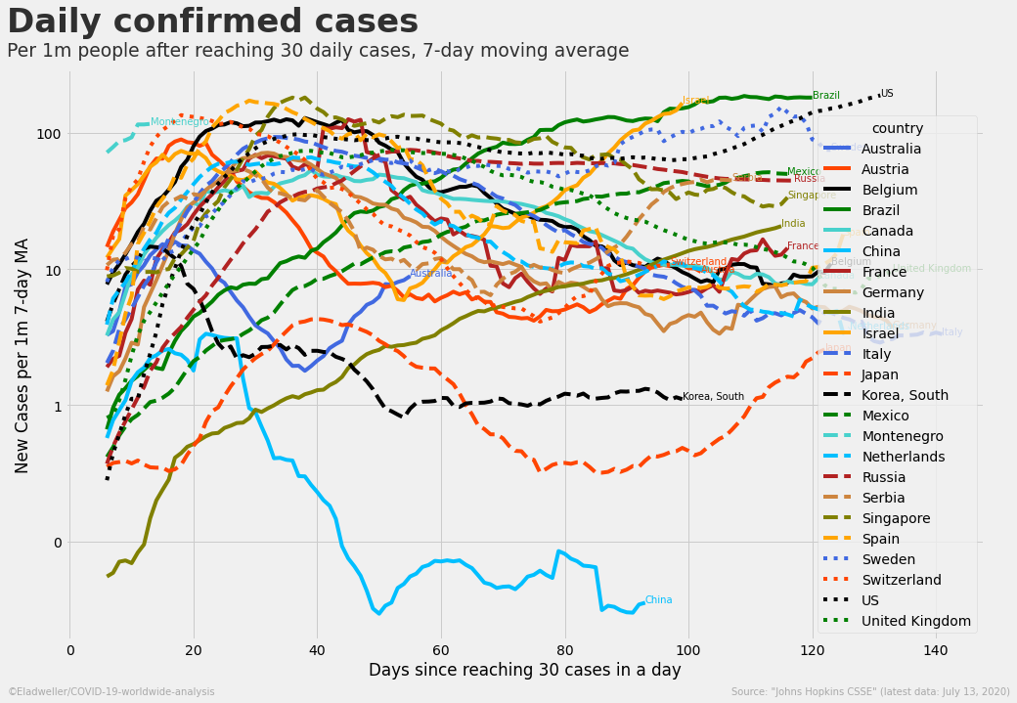

Slide 44
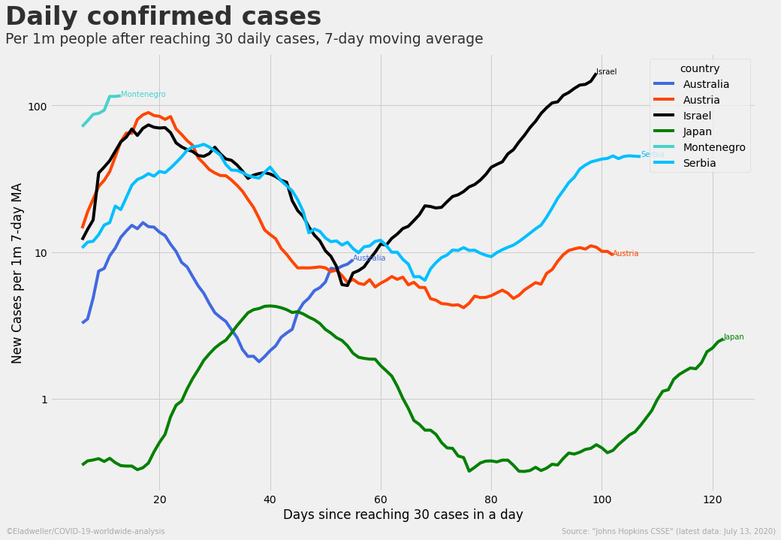

Slide 45
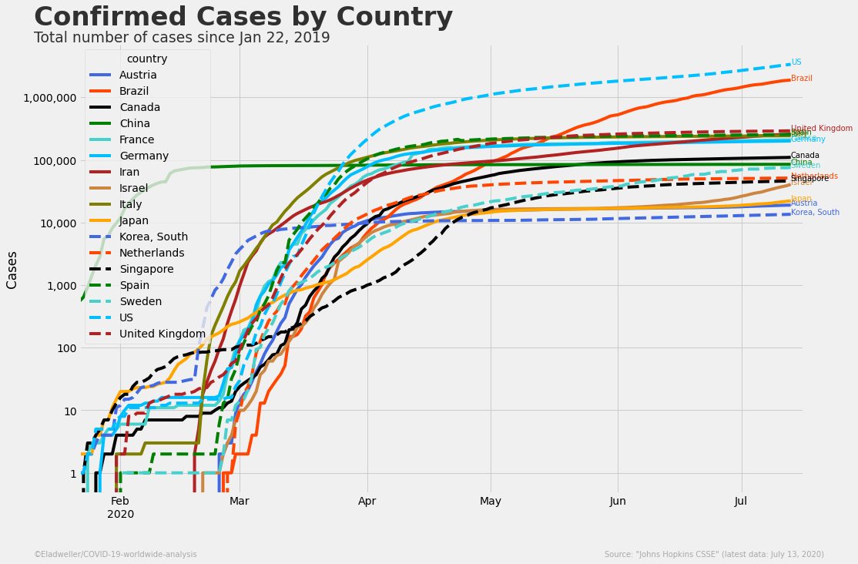

Slide 46
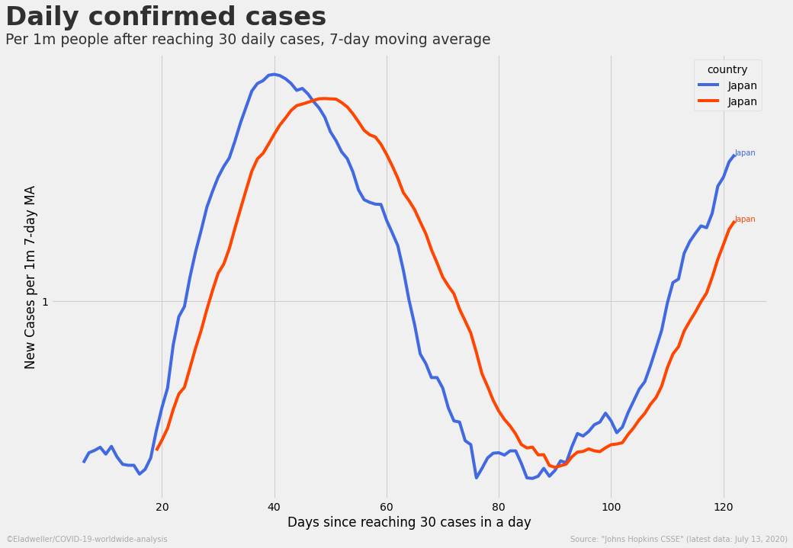

Slide 47
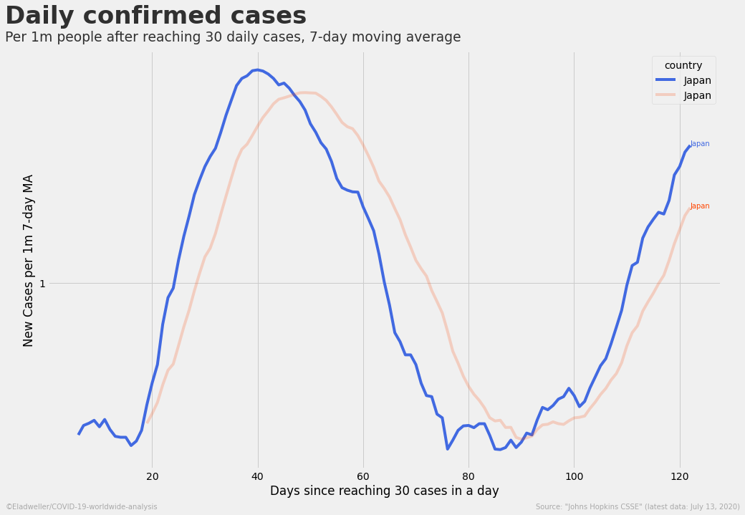

Slide 48
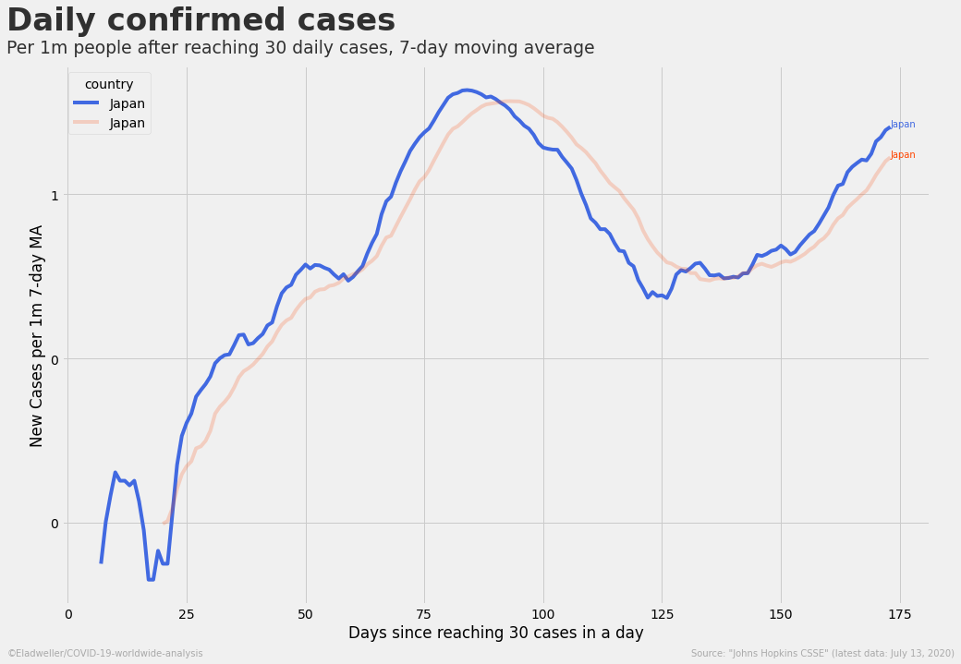

Slide 49
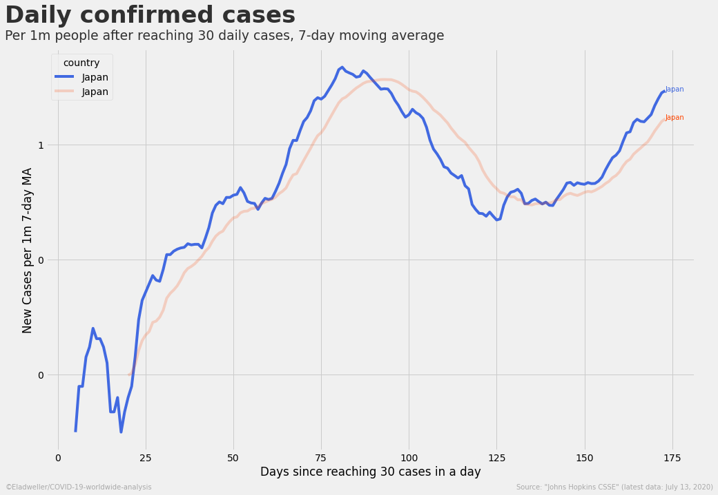

Slide 50
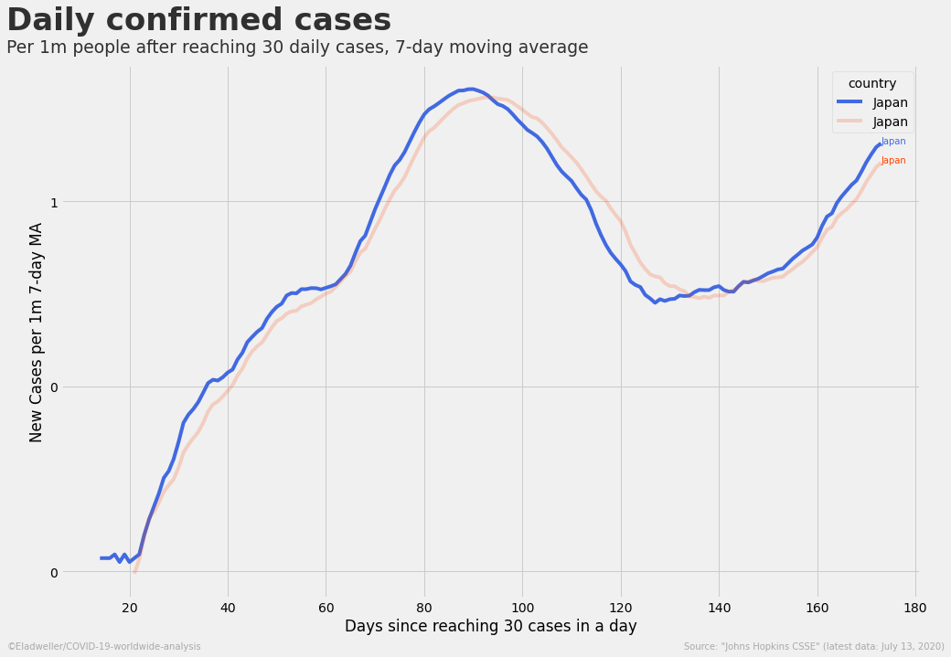

Slide 51
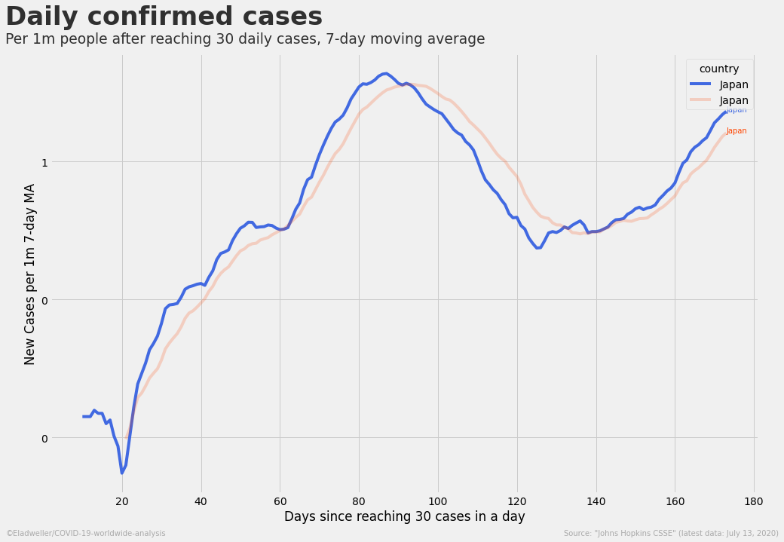

Slide 53
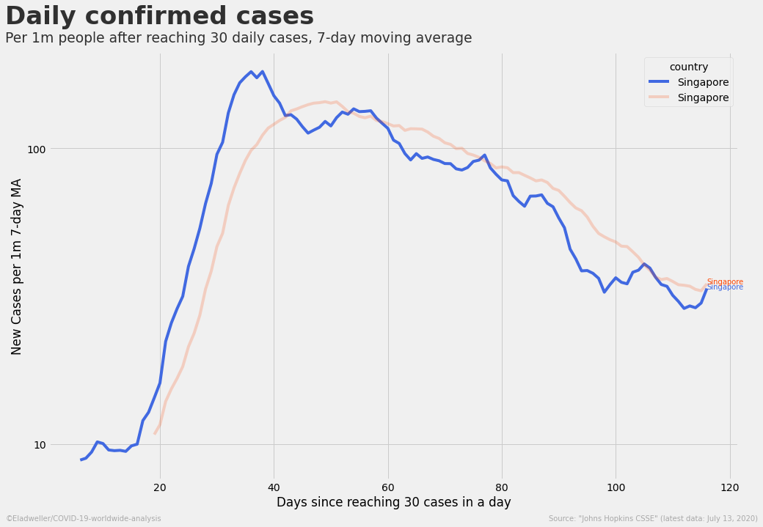

Slide 54
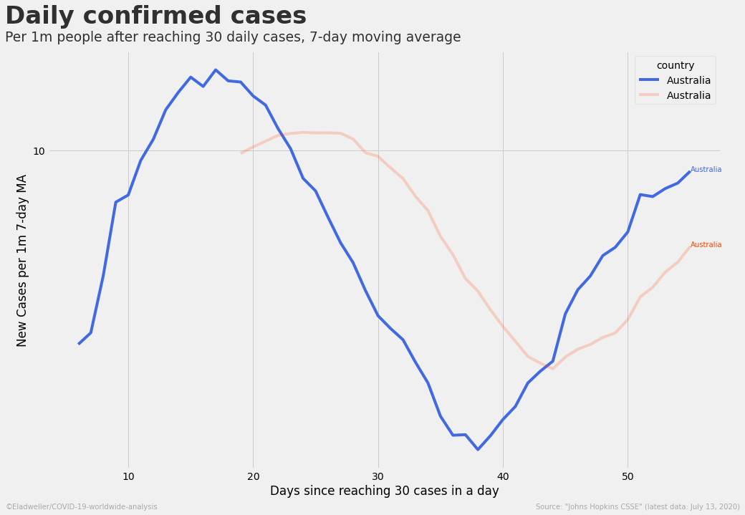

Slide 55


Slide 56


Slide 58


Slide 59


Slide 60


Slide 61


Slide 62


Slide 63


Slide 65


Slide 66


Slide 68


Slide 69


Slide 73


Slide 78


Slide 79


Slide 80


Slide 85


Slide 86


Slide 87


Slide 88


Slide 90


Slide 91


Slide 92


Slide 93


Slide 98


Slide 99


Slide 101


Slide 102


